Slide 1
Climate Trends in Cumberland County
Heidi Beardsley
Data 400
Oct. 3, 2024

Slide 2
Research Question
How have average annual temperature, the frequency of extreme heat days (above 90°F), and total annual precipitation changed in Cumberland County, PA, over the past 50 years (1973–2023), and how are these trends expected to continue or accelerate in the next 30 years (2024–2054)?

Slide 3
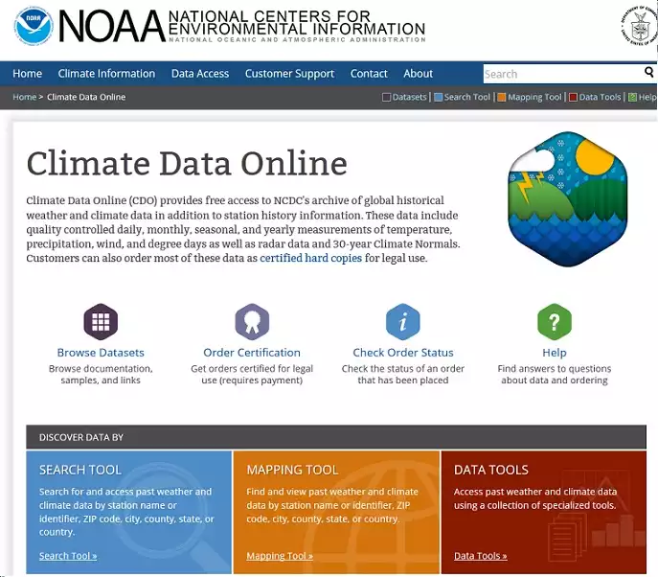
Tractable Data
NOAA Climate Data Online
Overview:
Provides access to a vast collection of U.S. and global weather and climate data.
Includes daily, monthly, and annual summaries from weather stations, radar, and satellite observations.
Data is structured to facilitate time-series analysis of climate variables such as temperature, precipitation, and extreme weather events.
Data:
Includes historical and real-time data on temperature, precipitation, wind, and more.
Useful for climate research, forecasting, agriculture, public health, and policy-making.

Slide 4
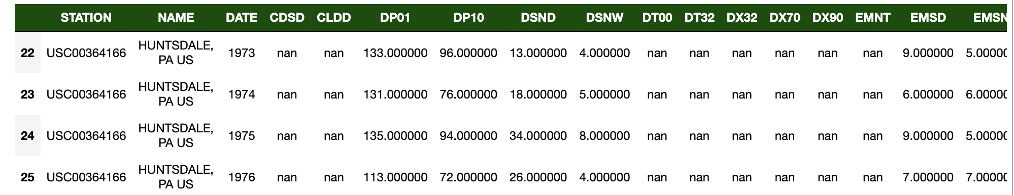
Data Retrieval
Queried the NOAA Climate Data Portal:
Date: 1900-2023
Location: Cumberland County, PA (all stations – 8 unique stations)
Variables: temperature variables, precipitation variables, date, location
Downloaded a CSV file, loaded into Python

Slide 5
Exploratory Data Analysis

Slide 6
Data Cleaning
Date:
Filtered for years greater than and equal to 1973 and less than or equal to 2023.
Sorted the rows by DATE.
Grouped by DATE and computed the mean to combined location values for the same year (since I am doing analysis by year not location).
Missing Values:
404 missing values (from variables I am analyzing).
Applied linear interpolation: maintains the trend and continuity, providing a more accurate representation of the temperature variations

Slide 7
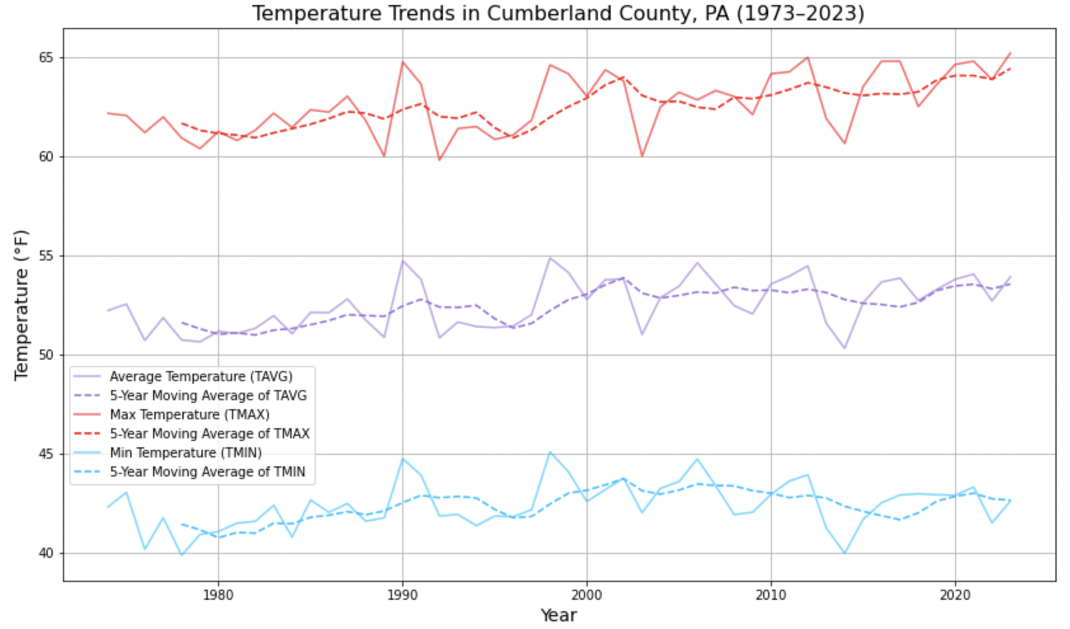

Slide 8
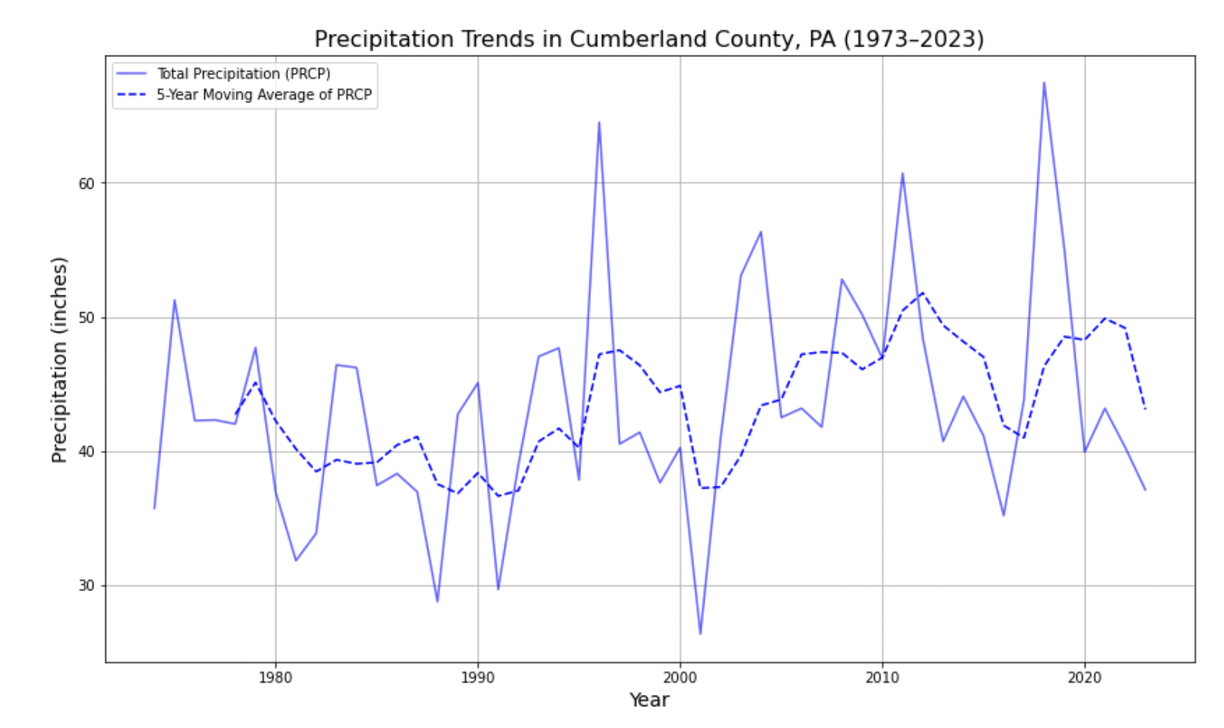
Table of contents
01
03
02
04
Section
Section
Section
Section

Slide 9
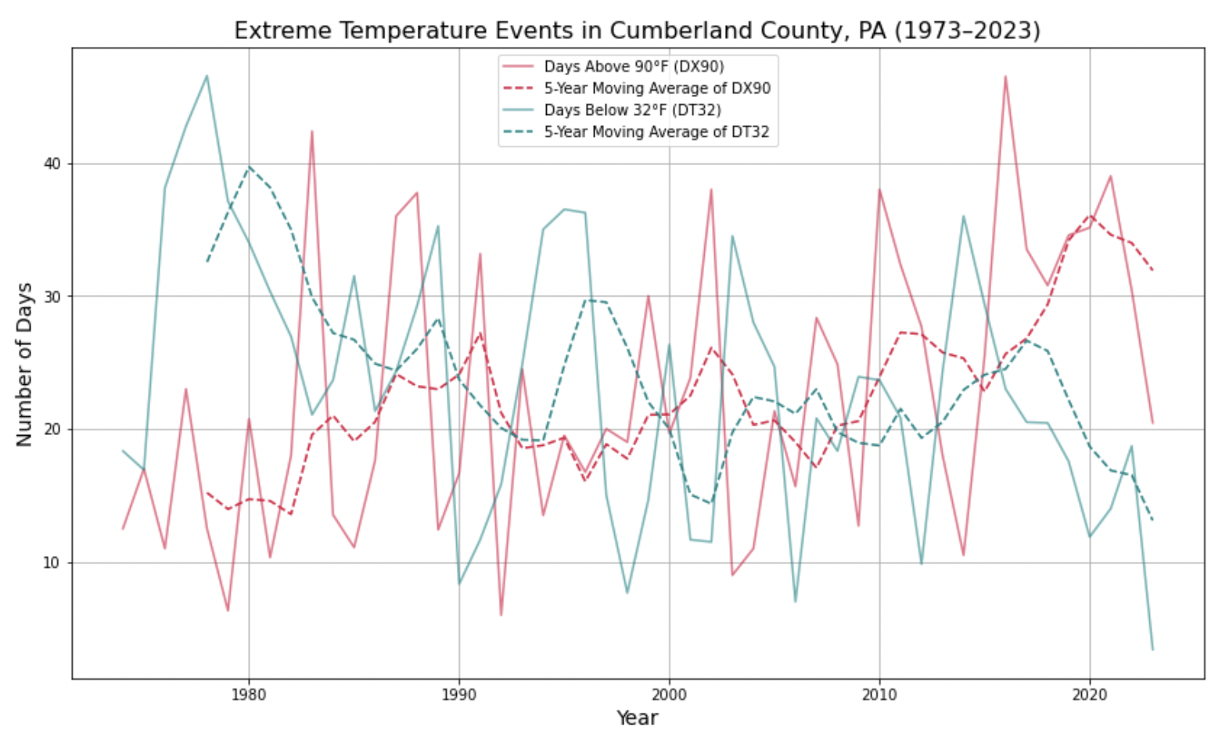
You can divide the content
Venus
Mercury
Venus has a beautiful name and is the second planet from the Sun. It’s terribly hot—even hotter than Mercury—and its atmosphere is extremely poisonous. It’s the second-brightest natural object in the night sky after the Moon
Mercury is the closest planet to the Sun and the smallest one in the Solar System—it’s only a bit larger than the Moon. The planet’s name has nothing to do with the liquid metal, since Mercury was named after the Roman messenger god

Slide 10
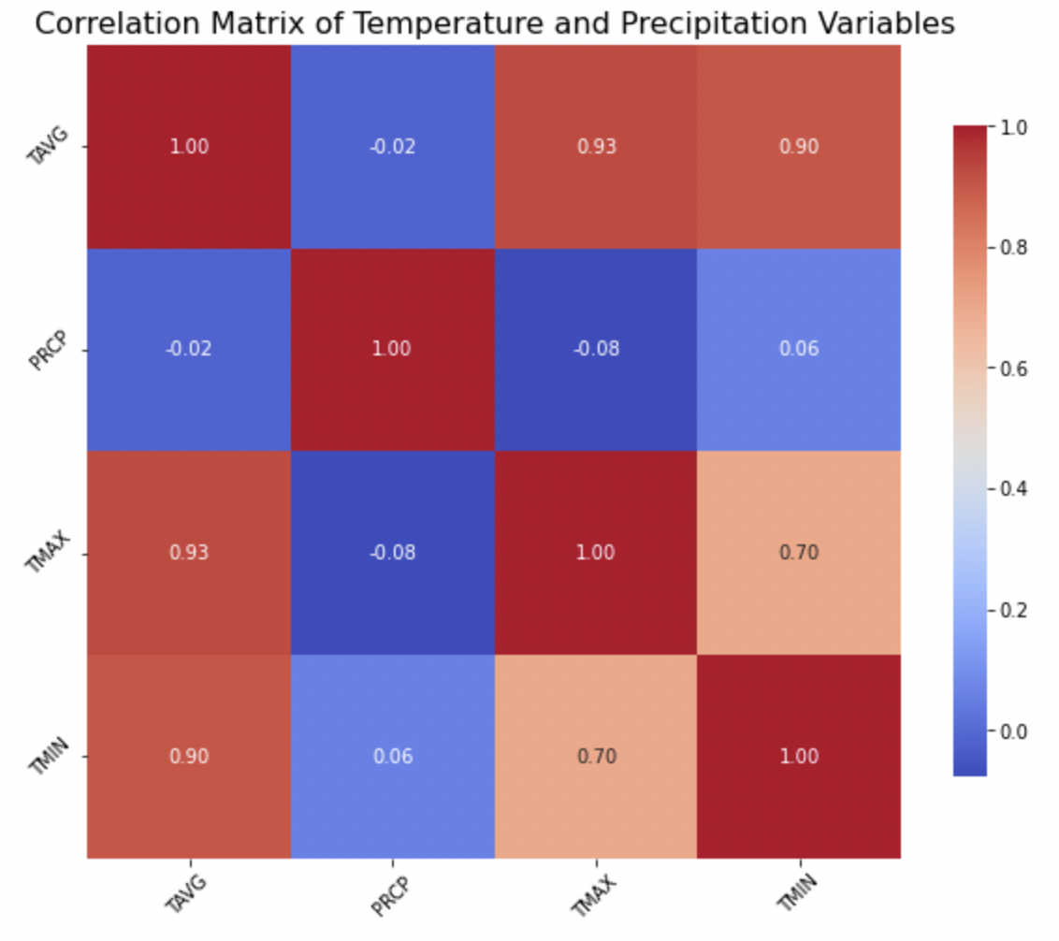

Slide 11
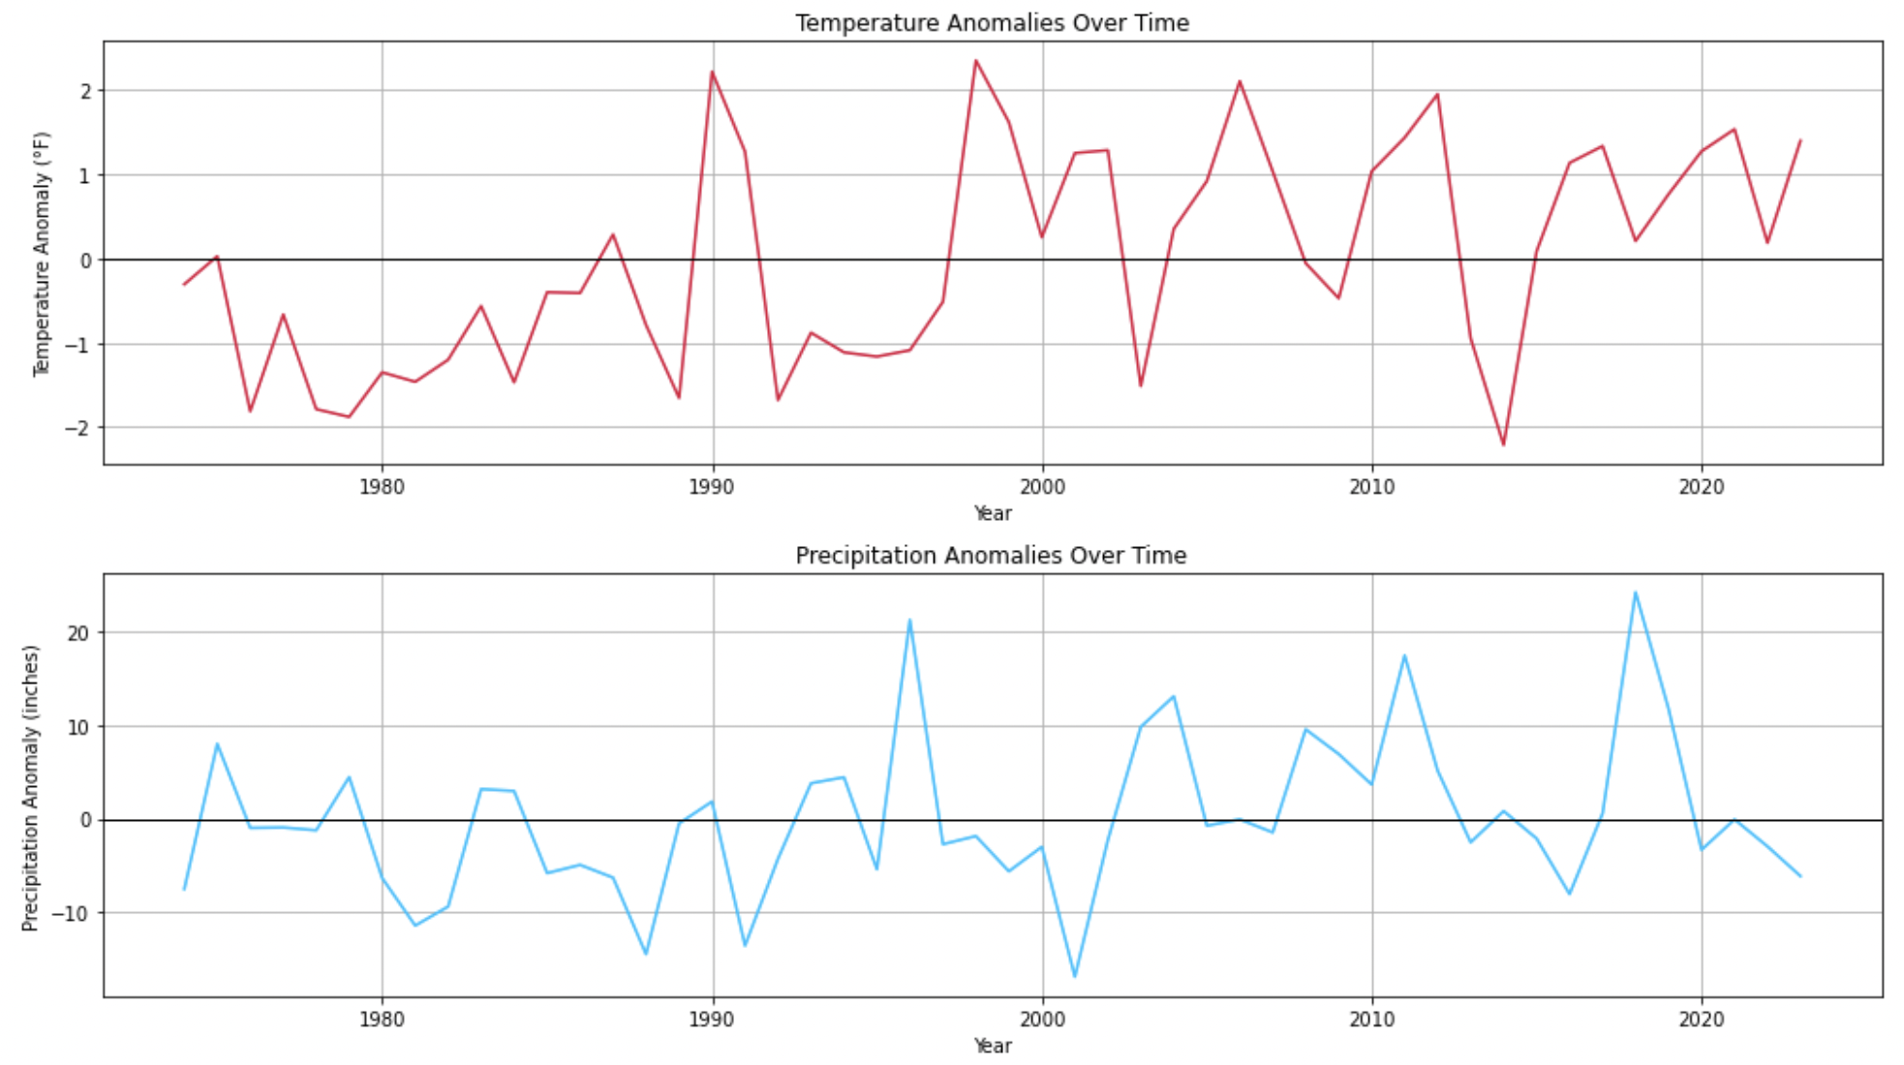
Divide the content into four ideas
Mars
Jupiter
Despite being red, Mars is actually a cold place. It's full of iron oxide dust, which gives the planet its reddish cast, and it’s made of basalt
Jupiter is a gas giant and the biggest planet in the Solar System. It's the fourth-brightest object in the night sky and named after a Roman God
Saturn
Venus
Saturn is a gas giant and has several rings. It's composed mostly of hydrogen and helium. It’s the sixth planet from the Sun
Venus has a beautiful name and is the second planet from the Sun. It’s terribly hot, even hotter than Mercury. It has a toxic atmosphere

Slide 12
Conclusion
Findings
Increase in Temperature: Observed rising average temperatures in Cumberland County over the years.
Increased Precipitation: Rise in total precipitation levels.
Extreme Weather Trends:
Days Above 90°F: Increase in the number of days exceeding 90°F.
Days Below 32°F: Decrease in the number of days falling below 32°F.
Yearly Variability: An increase in the number of years showing significant deviations from historical averages.
Next Steps: Time Series Analysis
Objective: Utilize time series analysis to predict future temperature and precipitation trends in Cumberland County. Utilize different climate scenarios to see how they differ.

Slide 13
Implications for Stakeholders
Farmers:
Adaptation Strategies: Adjust planting schedules and crop selection due to changing temperature and precipitation patterns.
Water Management: Implement efficient irrigation practices to cope with increased variability in rainfall.
Public Health Officials:
Heat-Related Health Risks: Prepare for an increase in heat-related illnesses, especially during hotter months.
Disease Vector Monitoring: Anticipate changes in disease patterns due to altered ecosystems and temperature increases.
Water Resource Managers:
Water Supply Planning: Adjust strategies for water resource management to account for increased precipitation variability.
Flood Risk Assessment: Enhance flood management plans in response to increased rainfall and extreme weather events.
Urban Planners:
Infrastructure Resilience: Design resilient infrastructure to withstand extreme weather and changing climate conditions.
Sustainability Initiatives: Promote green spaces and sustainable practices to mitigate urban heat effects.

Slide 14
Ethical, Legal, & Societal Implications
Ethical Considerations:
Data Accuracy and Integrity: Ensure the use of accurate and reliable data from the NOAA Climate Portal to uphold research integrity.
Transparency: Clearly communicate the data sources and methodologies used in research to promote transparency and trust.
Legal Implications:
Data Usage Rights: Adhere to NOAA's data usage policies and licensing agreements to ensure compliance with legal standards.
Attribution Requirements: Properly attribute the data source in any published research or presentations to respect intellectual property rights.
Societal Impacts:
Public Trust: Build community trust by using reputable data sources that inform stakeholders about climate change impacts and necessary adaptations.
Policy Influence: Leverage findings from the research to influence local policy decisions, promoting effective climate action based on solid data.
Community Engagement: Involve local communities in interpreting the data and discussing implications, fostering collective action toward sustainability.

Slide 15
Sources
National Oceanic and Atmospheric Administration. (n.d.). NOAA Climate Data Online: Climate data for Cumberland County, PA. Retrieved [September 15, 2023], from https://www.ncdc.noaa.gov/cdo-web/

